Slide 1
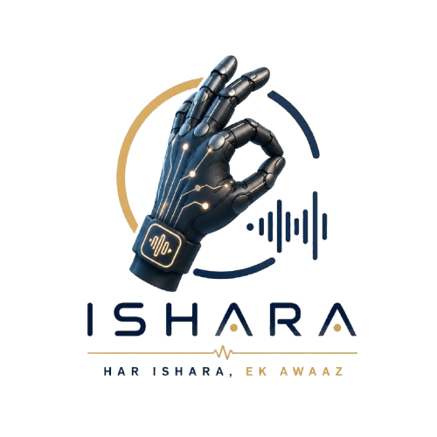
PRASUNETHON 2.0
Title Page
Team Name:
Kalki
Institute Name:
Narula Institute of Technology
Team members:
Prem Kumar Shaw
Md. Gufran
Ishrat Parveen
Title:
ISHARA
Breaking Communication Barriers
AI Powered Sign Language Translation
"Transforming silence into conversation through Artificial Intelligence."
Every Gesture Deserves a Voice
Next Slide
THE PROBLEM & WHY IT MATTERS.

Slide 2
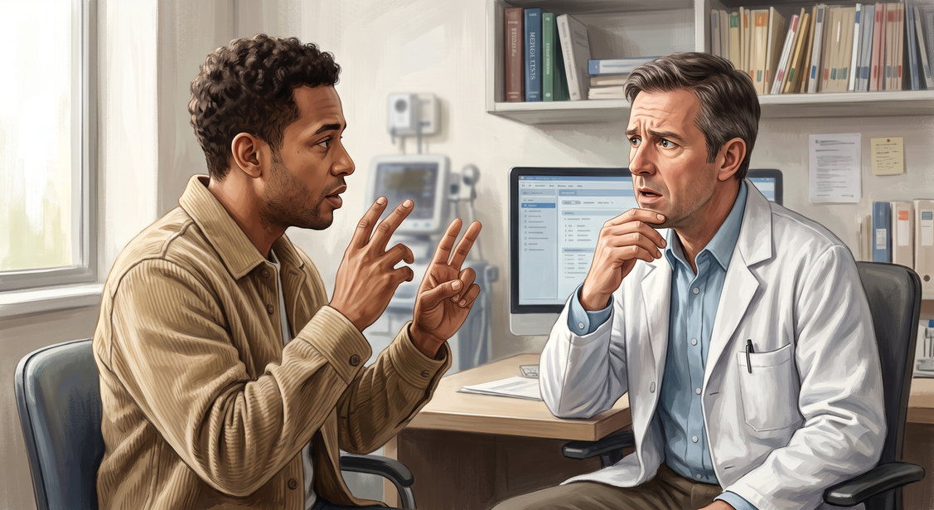

The Silent Communication Gap
Problem Statement
Existing Solution
Camera-Based Systems
  Sensitive to lighting
  Privacy concerns
  Occlusion issues
  Requires fixed setup
Existing Smart Gloves
  Expensive
  Bulky
  Limited adoption
  Difficult to scale
  Millions of peoples rely on sign language for daily communication.
  Most people cannot understand sign language.
  Communication barriers exist in hospitals, schools, banks, workplaces, and public services.
  Human interpreters are limited and not always available.
👥 70+ Million
People worldwide rely on sign language.
🏥 Millions in India
Need accessible communication support.
Next Slide
Why This Matters
Communication should never be a barrier to healthcare, education, employment, or dignity.
OUR SOLUTION

Slide 3

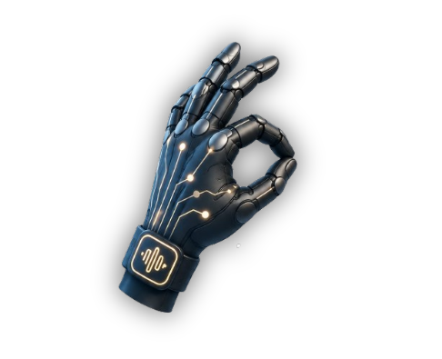
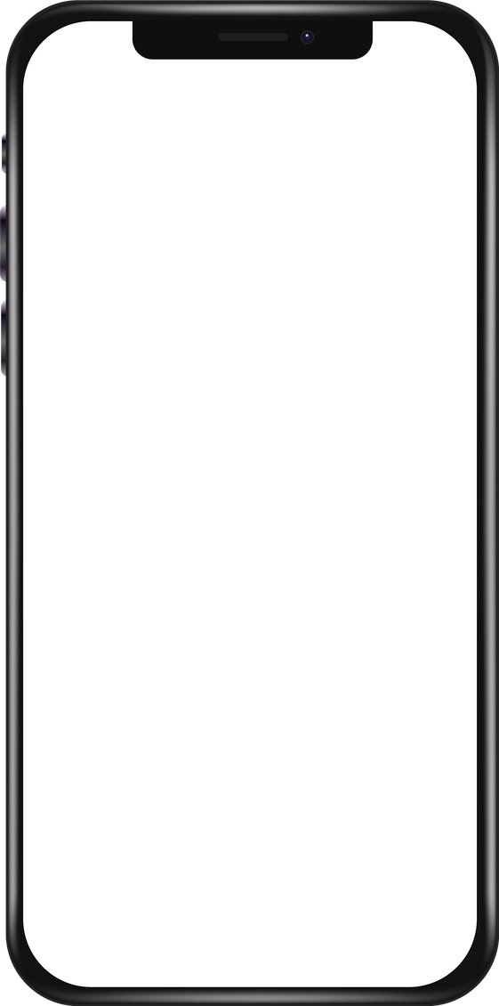
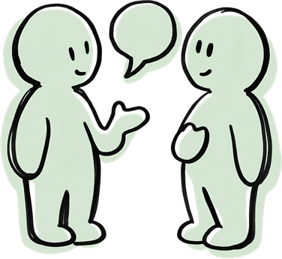

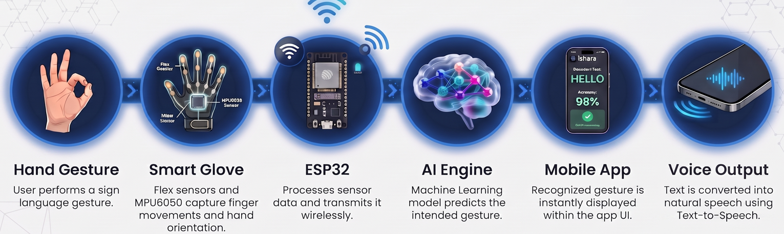
Introducing ISHARA
Gesture Detection
Har ISHARA Ek Awaaz
Seamless Communication
Key Features:
Low Cost Design
Gesture Detected
Sensor Based(No Camera)
“HELLO”
Mobile Applications
Voice Output: ”Hello”
WorkFlow:
Next Slide
ISHARA:
An affordable AI-powered wearable that transforms sign language into real-time text and speech, enabling seamless communication for everyone.
TECHNICAL APPROACH

Slide 4
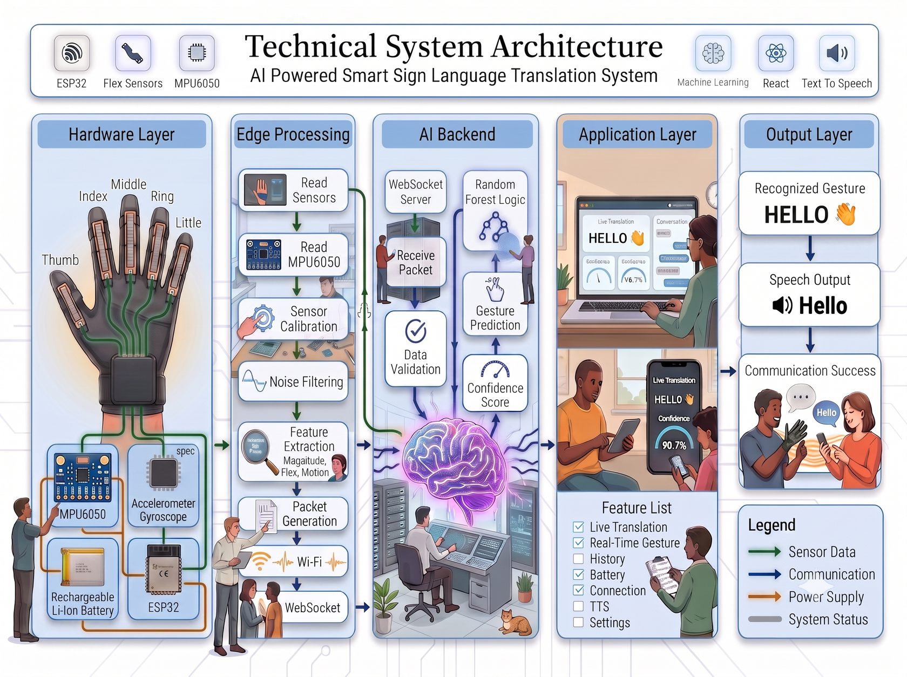
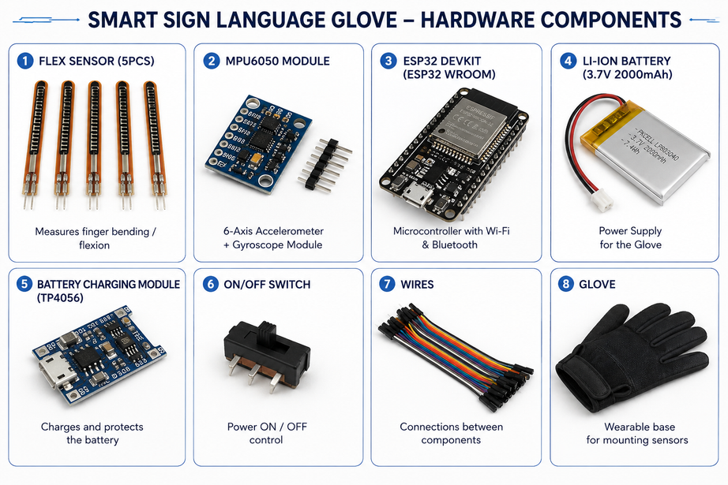
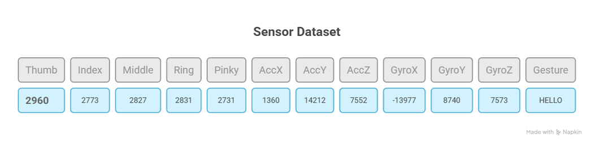
Technical Approach
System Architecture
Software Used
FRONTEND: React Native Expo, TypeScript
BACKEND AND API: Express.js, node.js, FastAPI
DATABASE: MongoDB
ML MODEL: Random Forest Classifier
DATA AND MODEL HANDELING: Python, Scikit-Learn, Numpy, Pandas, serial, CSV data logging
COMMUNICATION: Socket.io-client
SECURITY & CONFIG: CORS, DOTENV
Hardware Used
EXAMPLE SENSOR DATA FROM GLOVES TO ML MODEL
Next Slide
LIVE DEMO AND USER EXPERIENCE
AI INTELLIGENCE & GESTURE RECOGNITION

Slide 5
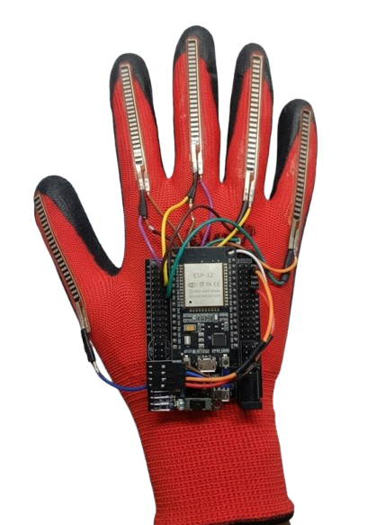
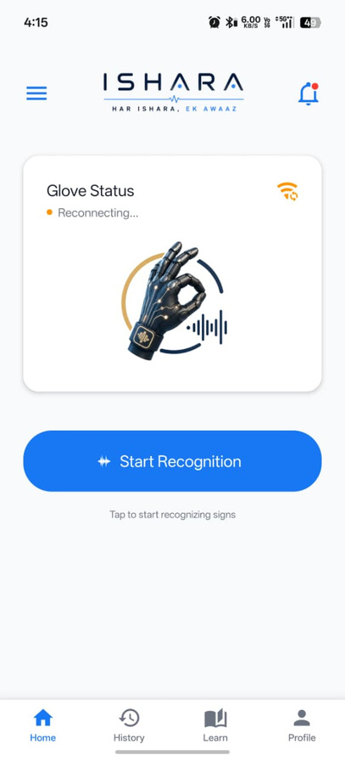
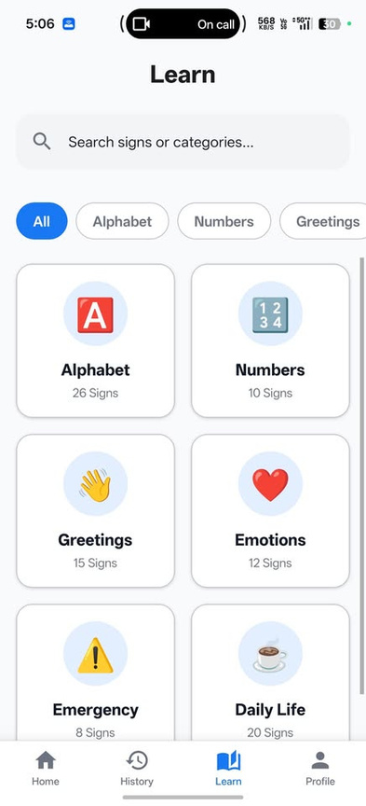
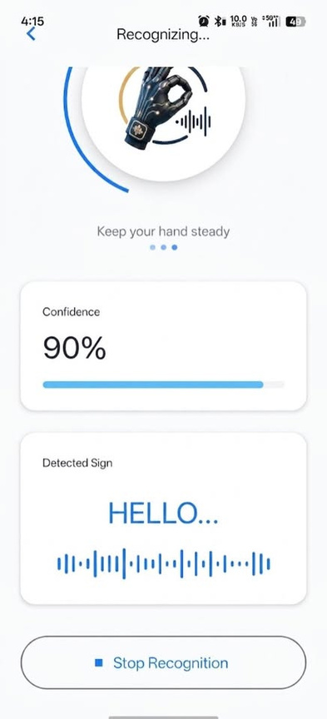
Live Demo & User Experience
ISHARA: Our sensor based gloves
for recognition
Home Screen of our App
Start Recognition Page
Next Slide
Learn Page for Understanding and Learning all the Signs
INNOVATION & COMPETITIVE EDGE

Slide 6
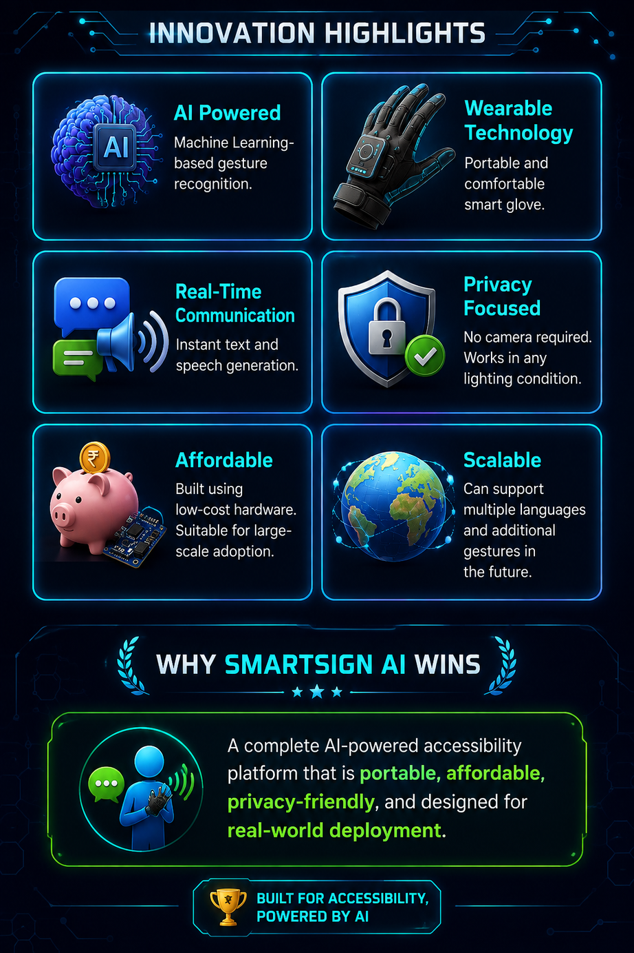
Innovation & Competitive Edge
Feature | Camera Systems | Smart Gloves | ISHARA
Portable | No❌ | Yes✅ | Yes ✅
Low Cost | No❌ | No❌ | Yes ✅
AI-Based Recognition | ⚠️ | Yes✅ | Yes ✅
Wireless | No❌ | ⚠️ | Yes ✅
Privacy Friendly | No❌ | Yes✅ | Yes ✅
Real-Time Speech | ⚠️ | Yes✅ | Yes ✅
App Integration | No❌ | No❌ | Yes ✅
Scalable | ⚠️ | ⚠️ | Yes ✅
Next Slide
IMPACT AND FUTURE VISION
A Step to make this world a better Place for Everyone

Slide 7
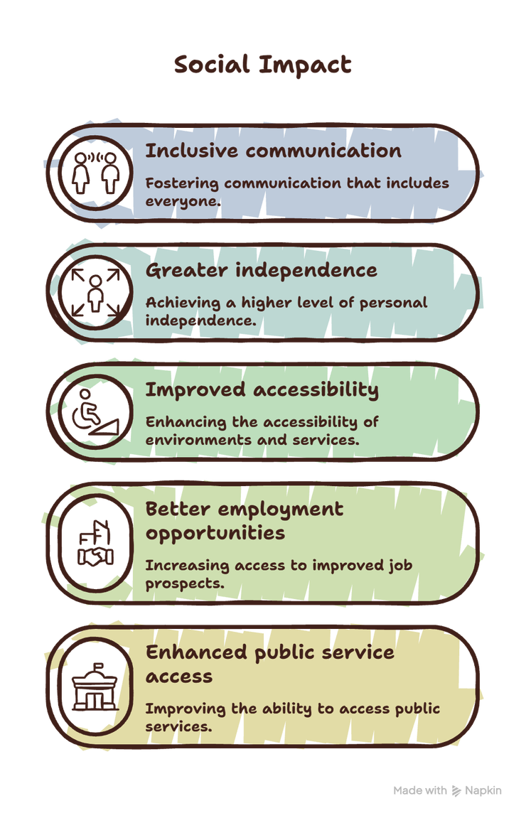
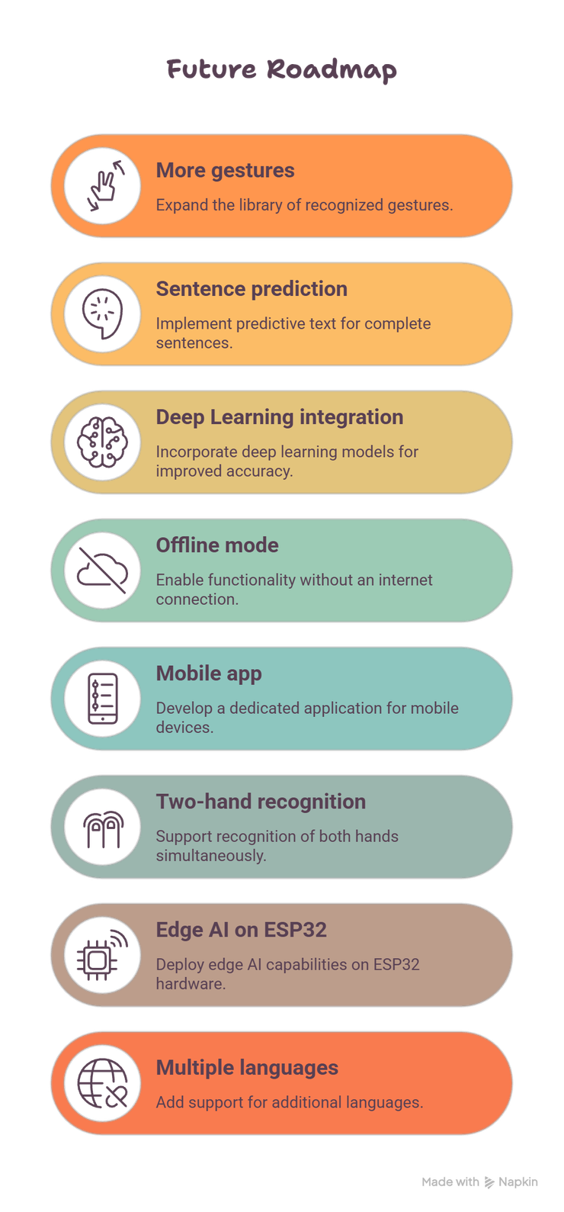

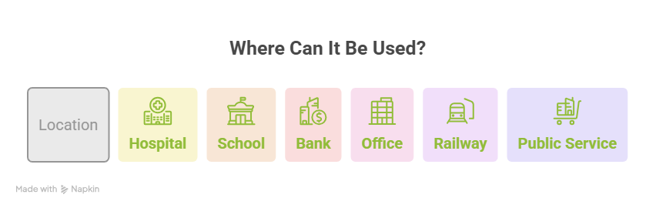
Impact & Future Vision
Improvements
Applications
Next Slide
BUSINESS AND REVENUE MODEL
A complete AI-powered accessibility platform that is portable, affordable, and designed for real-world deployment.

Slide 8
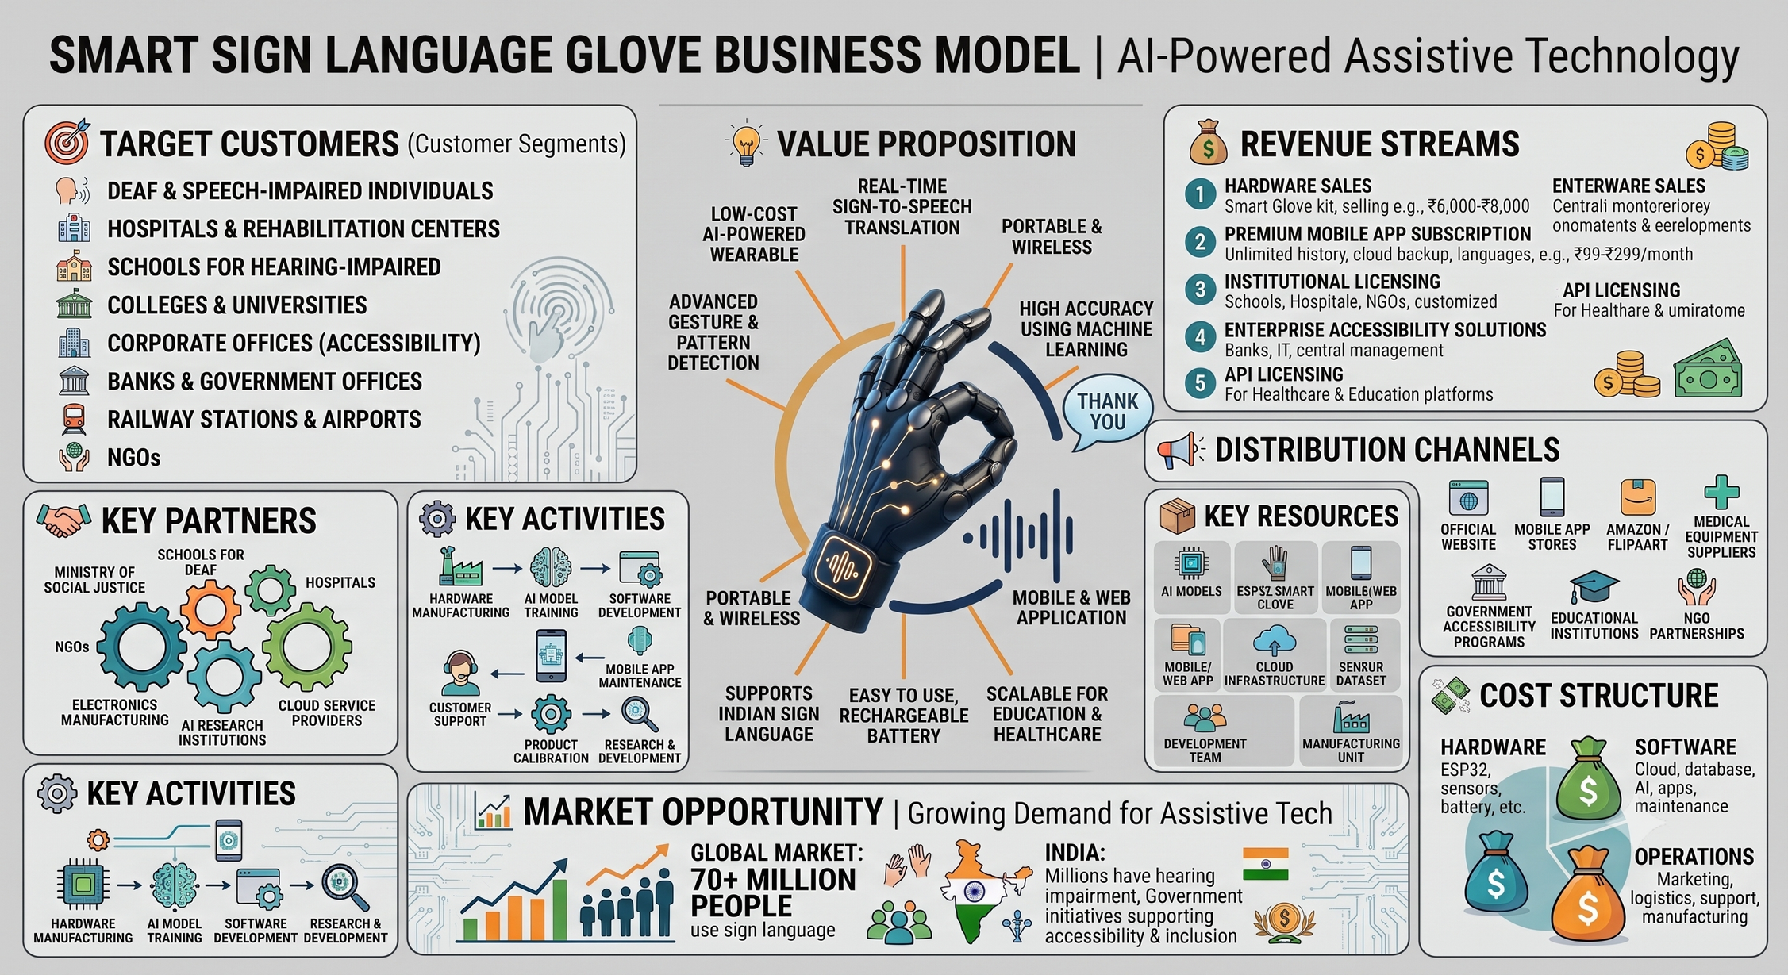
Business & Revenue Model
CONTENT

Slide 9


THANK YOU
For Your Attention
-

